Slide 1
PROBABILITY & STATISTICS
Chapter 7: Point Estimation of Parameters
Learning objectives
Introduction
Sampling Distributions
General Concepts Of Point
Estimation Methods Of Point Estimation

Slide 2
SET UP PROBLEM
Introduction
Let X is a random variable with probability distribution f(x), which is characterized by the unknown θ = (θ₁, θ₂, …, θ_{k})
For example, X ~ N(µ, σ²) then θ = (µ, σ²).
How to “determine” the values of θ?

Slide 3
PROBLEMS IN ENGINEERING
Introduction
In engineering, we often need to estimate
The mean μ of a single population.
The variance σ² (or standard deviation ) of a single population.
The proportion p of items in a population that belong to a class of interest.
The difference in means of two populations, μ₁ – μ₂ .
The difference in two population proportions, p₁ – p₂ .

Slide 4



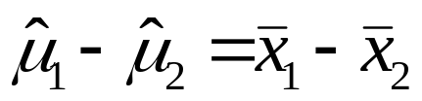
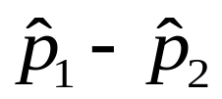
PROBLEMS IN ENGINEERING
Introduction
The important results on point estimation
For μ , the estimate is the , sample mean.
For σ² , the estimate is , the sample variance.
For p, the estimate is , the sample proportion.
For μ₁ – μ₂ , the estimate is
For p₁ – p₂ , the estimate is

Slide 5

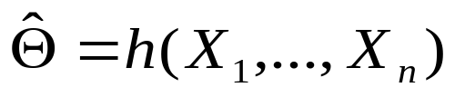
SAMPLING DISTRIBUTIONS
Definition Random Sample
Sampling Distributions
The random variables X₁, …., X_{n} are called a random sample of size n if
The X_{i}’s are independent
Every X_{i} has the same probability distribution
Definition Statistic
A statistic is any function of the observations X₁, …, X_{n}:
The probability distribution of a statistic is called a sampling distribution.

Slide 6

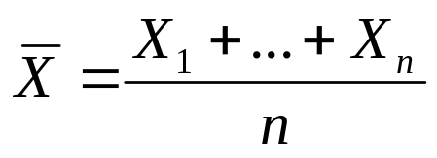
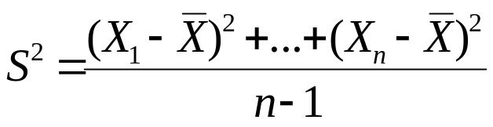
SAMPLING DISTRIBUTIONS
Example Two important statistic
Sampling Distributions
Sample mean
Sample variance S²

Slide 7
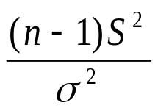
SAMPLING DISTRIBUTIONS
Theorem
Sampling Distributions
In above example, if (X₁, …., X_{n}) is a random sample of size n take from a normal distribution N(μ, σ²) then
has a normal distribution N(μ, σ²/n)
has a chi-square distribution with n-1 degrees of freedom (see pages 273-274).

Slide 8
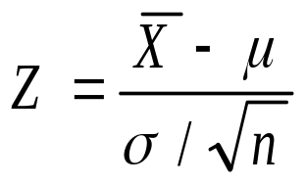

SAMPLING DISTRIBUTIONS
Theorem Central Limit Theorem
Sampling Distributions
Let (X₁, …., X_{n}) is a random sample of size n take from a population with mean μ and finite variance σ², and if is the sample mean, the limiting form of the distribution of
As , is the standard normal distribution.
Remark: The normal approximation for depends on the sample size n.

Slide 9
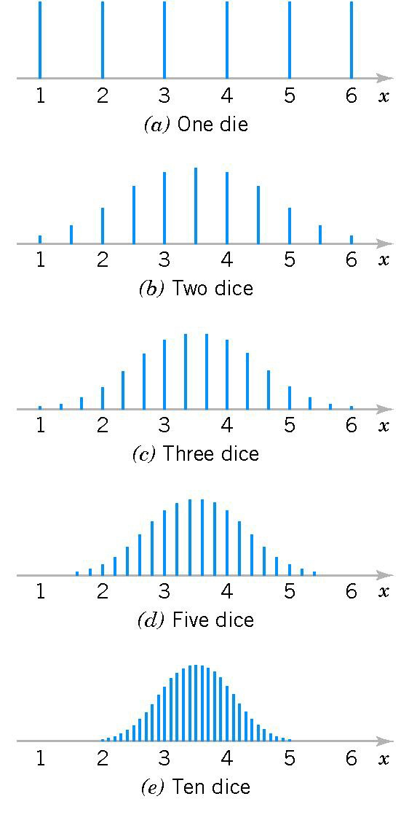
SAMPLING DISTRIBUTIONS
Sampling Distributions
Figure 7-1 Distributions of average scores from throwing dice.

Slide 10

SAMPLING DISTRIBUTIONS
Definition Point Estimate
Sampling Distributions
A point estimate of some population parameter θ is a single numerical value of a statistic .
The statistic is called the point estimator.
Two steps to find point estimation:
Step 1. Determine by using the theoretical results.
Steps 2. Calculate from the experimental data.

Slide 11
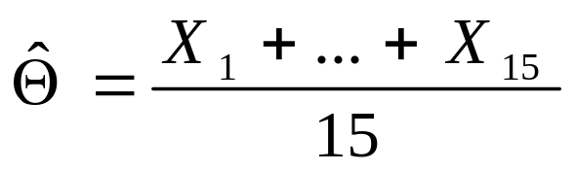
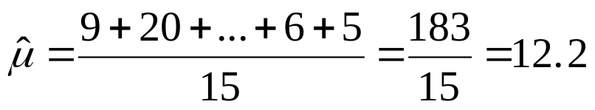
SAMPLING DISTRIBUTIONS
Example
Sampling Distributions
Market researchers use the number of sentences per advertisement as a measure of readability for magazine advertisements. The following represents a random sample of the number of sentences found in 15 advertisements. Find a point estimate of the population mean, μ.
9 20 18 16 9 9 11 13 22 16 5 18 6 6 5
Step 1.
Step 2. A point estimate for μ is

Slide 12
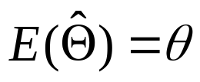
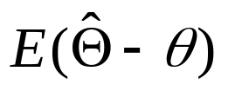
UNBIASED ESTIMATOR
Definition Unbiased Estimator
The point estimator is an unbiased estimator for the parameter θ if
If the estimator is not unbiased, then the difference
is called the bias of the estimator .
General concepts of point estimation

Slide 13
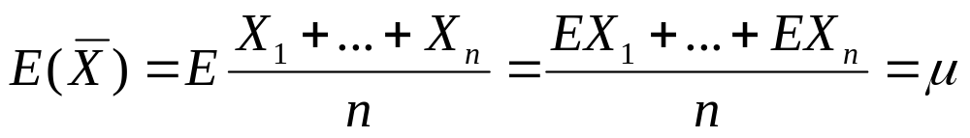
UNBIASED ESTIMATOR
Example
Suppose that X is a random variable with mean μ and variance σ². Let X₁, …, X_{n} be a random sample of size n from the population represented by X. Show that the sample mean and sample variance S² are unbiased estimators of μ and σ², respectively.
General concepts of point estimation
For the sample mean.

Slide 14
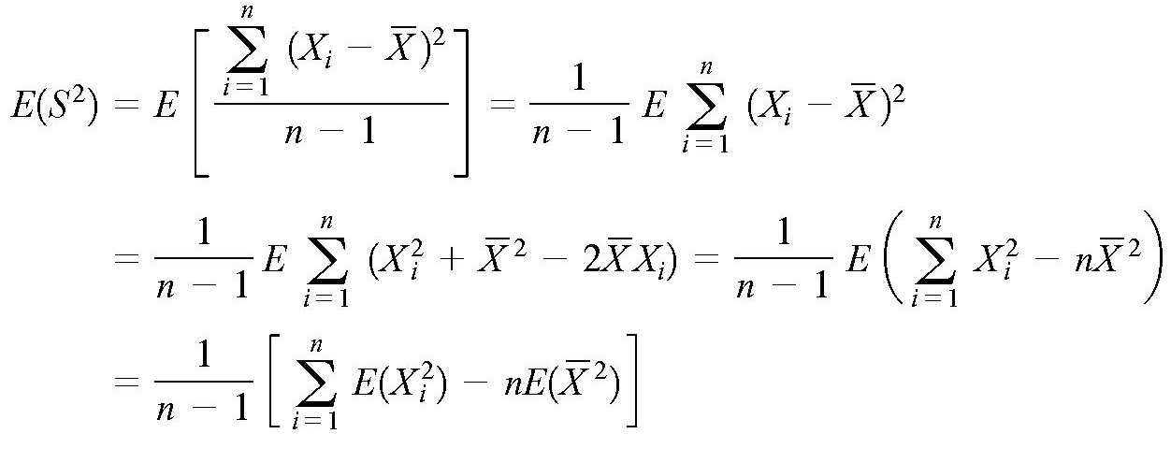
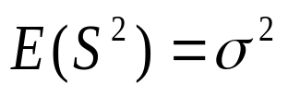
UNBIASED ESTIMATOR
Now consider the sample variance. We have
General concepts of point estimation
Hence

Slide 15
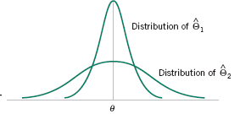

MINIMUM VARIANCE UNBIASED ESTIMATOR
Definition Minimum Variance Unbiased Estimator
If we consider all unbiased estimators of θ, the one with the smallest variance is called the minimum variance unbiased estimator (MVUE).
General concepts of point estimation
Figure 7-5 The sampling distributions of two unbiased estimators

Slide 16
MINIMUM VARIANCE UNBIASED ESTIMATOR
Theorem
Let (X₁, …., X_{n}) is a random sample of size n take from a normal distribution N(μ, σ²) , the sample mean is the MVUE for μ.
General concepts of point estimation

Slide 17
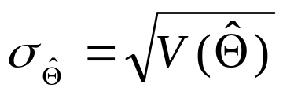
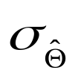
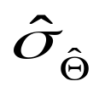
STANDARD ERROR
Definition Minimum Variance Unbiased Estimator
The standard error of an estimator is its standard deviation, given by
If the standard error involves unknown parameters that can be estimated, substitution of those values into produces an estimated standard error, denoted by
General concepts of point estimation
Remark
If the random sample of size n take from a normal distribution N(μ, σ²) then has a normal distribution N(μ, σ²/n).

Slide 18
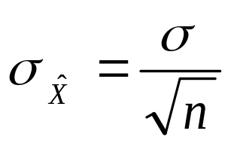
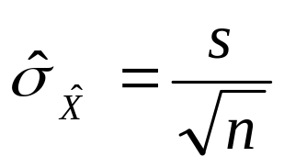
STANDARD ERROR
Standard error of is
General concepts of point estimation
If we did not know σ then the estimated standard error of
would be

Slide 19
STANDARD ERROR
Exercise
A new method of measuring the thermal conductivity of Armco iron: Using a temperature of 100⁰F and a power input of 550 watts, the following 10 measurements of thermal conductivity (in Btu/hr-ft-⁰F) were obtained:
41.60, 41.48, 42.34, 41.95, 41.86,
42.18, 41.72, 42.26, 41.81, 42.04
a, Find a point estimate of the mean thermal conductivity at 100⁰F and 550 watts.
b, Find the estimated standard error of
General concepts of point estimation

Slide 20
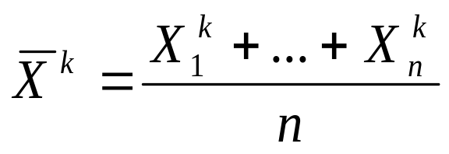
METHOD OF MOMENTS
Definition The kth moments
Let (X₁, …., X_{n} ) be a random sample from random variable X with the probability distribution f (x)
The kth moment of X are denoted by M_{k} := E(X^{k})
The corresponding kth sample moment is
Method of
moments

Slide 21
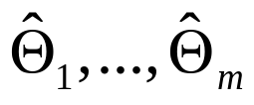
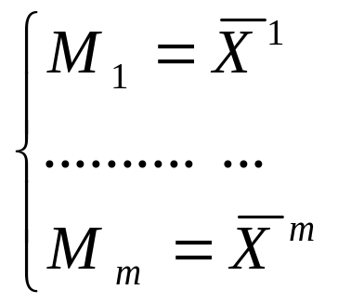
METHOD OF MOMENTS
Definition The kth moments
Let (X₁, …., X_{n} ) be a random sample from either a probability mass function or probability density function with m unknown parameters (θ₁, θ₂, …,θ_{m}). The moment estimators are found the following system
Method of
moments

Slide 22
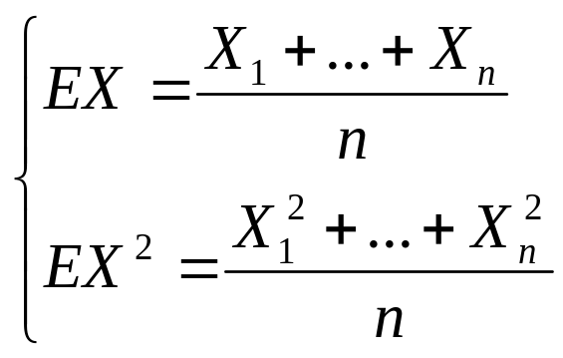
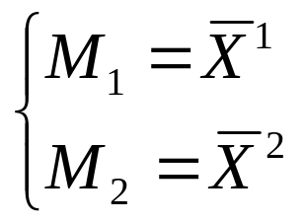
METHOD OF MOMENTS
Example
Suppose that X₁, …, X_{n} be a random sample of size n from a normal distribution N(μ, σ²). Find the moment estimators of μ and σ².
We have to solve following system
Method of
moments
or
Here E(X) = μ and E(X²) = V(X) +(EX)² = σ² + μ²

Slide 23
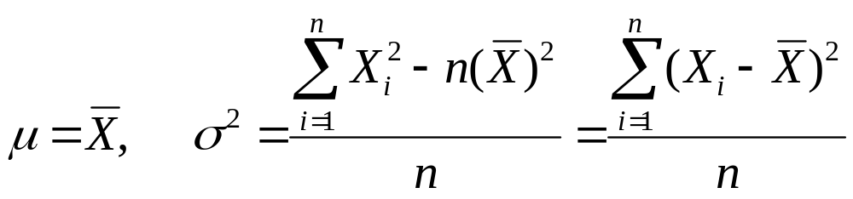
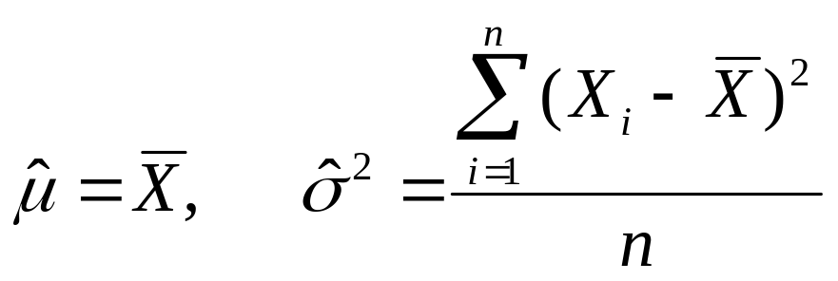
METHOD OF MOMENTS
Hence, by solving the above system we have
Finally, the moment estimators are
Method of
moments
Biased estimator
Unbiased estimator

Slide 24
METHOD OF MAXIMUM LIKELIHOOD
Definition Maximum likelihood Estimator
Suppose that X is a random variable with probability distribution f (x, θ ), where θ is a single unknown parameter. Let x₁, x₂, , x_{n} be the observed values in a random sample of size n. Then the likelihood function of the sample is
L(θ) = f(x₁, θ) f(x₂, θ)…f(x_{n}, θ)
The maximum likelihood estimator (MLE) of θ is the
value of θ that maximizes the L(θ).
Method of
maximum
likelihood

Slide 25
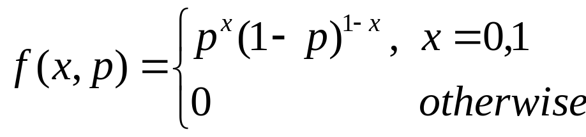
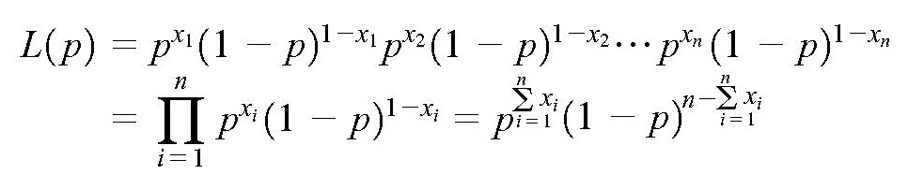
METHOD OF MAXIMUM LIKELIHOOD
Example
Let X is a Bernoulli random variable. The probability mass function is
Find the maximum likelihood estimator of p.
The likelihood function of a random sample of size n is
Method of
maximum
likelihood

Slide 26
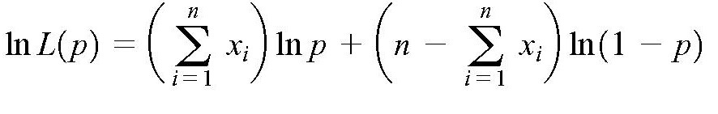
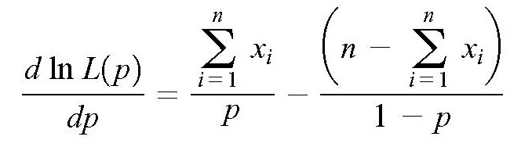
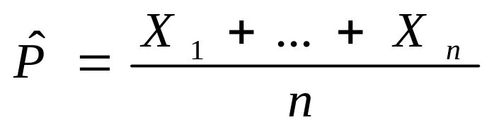
METHOD OF MAXIMUM LIKELIHOOD
The maximum likelihood estimator of p is
Method of
maximum
likelihood
Is this a unbiased estimator?

Slide 27
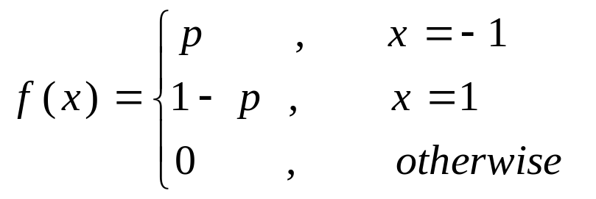
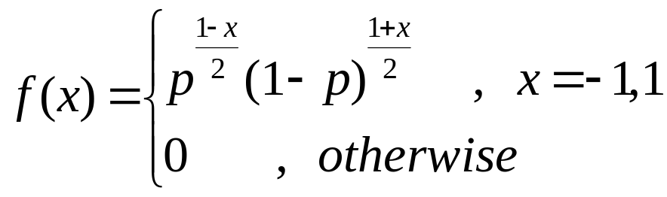
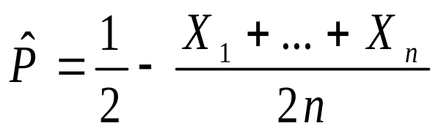
METHOD OF MAXIMUM LIKELIHOOD
Exercise
Let X is a random variable, which has probability mass function is
Find the maximum likelihood estimator of p.
Solution:
Method of
maximum
likelihood

Slide 28




METHOD OF MAXIMUM LIKELIHOOD
Invariance Property
Let be the maximum likelihood estimators of the parameters . Then the maximum likelihood estimator of any function of these parameters is the same function of the estimators .
Method of
maximum
likelihood

Slide 29
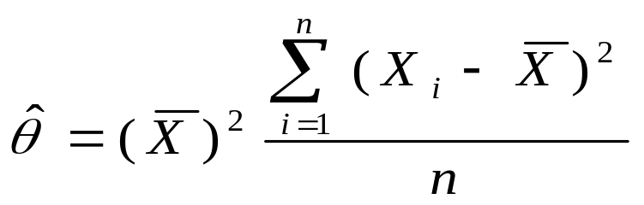
METHOD OF MAXIMUM LIKELIHOOD
Exercise
Let X be normally distributed N(μ, σ²), where both μ and σ² are unknown.
Find the maximum likelihood estimator of μ and σ².
(b) Find the maximum likelihood estimator of θ = μ²σ².
Solution:
Method of
maximum
likelihood

Slide 30
SUMMARY
We have studied:
1. Sampling distributions
2. General concepts of point estimation: Unbiased Estimator
3. Methods of point estimation
Method of Moments
Method of Maximum Likelihood
Homework: Read slides of the next lecture.
Summary

